Slide 1


COUNCIL EXAMS
FOR FOREIGN TRAINED DOCTORS
&
INTERNSHIP PROCESS OF MEDICAL AND DENTAL PRACTITIONERS
EXAM BRIEFING FOR FOREIGN TRAINED DOCTORS
Friday 4th September 2020
DR. JACQUELINE KITULU
CHAIR - TRAINING, ASSESSMENT, REGISTRATION AND HUMAN RESOURCE COMMITTEE (TAR & HRC)
KENYA MEDICAL PRACTITIONERS AND DENTISTS COUNCIL

Slide 2
COUNCIL EXAMS
FOR FOREIGN TRAINED DOCTORS

Slide 3
COUNCIL EXAMS FOR
FOREIGN TRAINED DOCTORS
Foreign trained doctors who possess qualifications equivalent to MBChB and BDS from University of Nairobi are required to sit Council exams in order to determine their eligibility for either registration or internship training
These exams are given under Cap. 253 Section II. However, graduates from the East African Partner States (EAC) who qualify from approved medical and dental schools are exempted from Council exams under EAC Boards/Councils Reciprocal Recognition
Council Exams for Foreign Trained doctors
Notes:
The Mandate is to regulate
training,
practice and
licensing of medicine & dentistry, Hospitals, Medical Centre and Clinics

Slide 4

TYPES OF EXAMS
TYPE OF EXAMS
Internship Qualifying Examination (IQE)
IQE is administered to newly qualified graduates who have not undergone internship training at their country of training.
Candidates who pass those exams will be required to submit a copy of posting letter from the Ministry of Health in order to be issued with Internship License by the Council.
Note: It is an offence to undertake internship training without the internship license.
Contd…….

Slide 5
TYPE OF EXAMS
Pre-Registration Examination
This examination is administered to graduates who upon completion of their training undertake the mandatory internship training at their country of training and should have been registered therein.
Candidates who pass this exam are thus are required to apply for Permanent Registration in the prescribed manner.

Slide 6

MODE OF EXAM
The examination is divided into two (2):-
Written – 100 marks
Clinical – 100 marks
Pass mark is 50%. However, a candidate must attain a pass mark of 50% in clinicals in order to be awarded a pass in the entire exam.

Slide 7
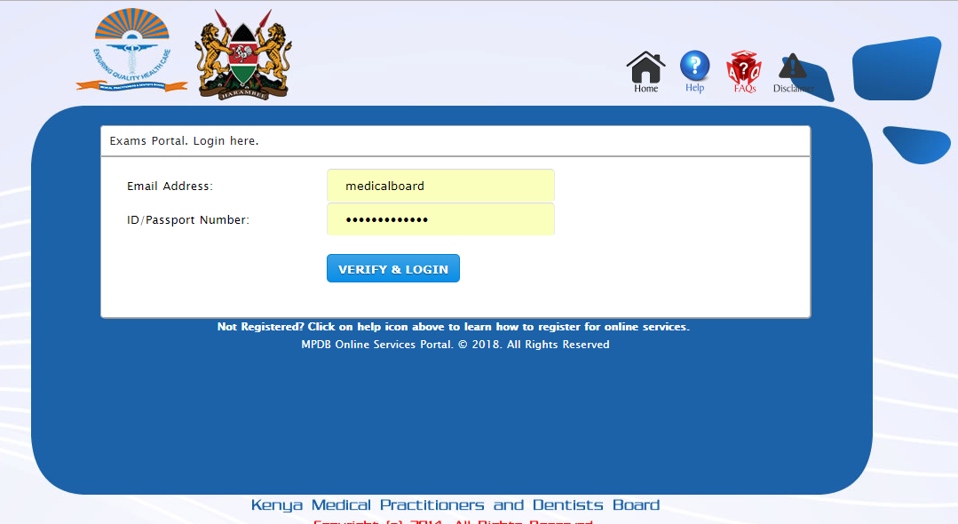
ONLINE RELEASE OF EXAM
http://portal.medicalboard.co.ke/results
NOTE: you are strongly advised to provide your correct email and ID No./Passport No

Slide 8

EXAM SITTINGS
Candidates are allowed a maximum of three (3) exam attempts only

Slide 9

APPEAL
All appeals are addressed to the Chair of the Council within Seven (7) days and the decision therein is final.

Slide 10
INTERNSHIP PROCESSESINTERNSHIP PROCESS OF MEDICAL AND DENTAL PRACTITIONERS

Slide 11
PRESENTATION OUTLINE
Internship Process
Internship Goals
Internship Requirements
Responsibilities of an intern
Failure to complete internship
Consequences of not completing internship
Registration after internship

Slide 12
INTERSHIP
Internship is a period of supervised practical work for medical and dental graduates where they serve in hospitals for a specified period before registration.
Every intern shall be required to undergo an internship training program for a period of 13 months.
List of approved Internship Training Centres on www.kmpdc.go.ke
Every intern will be required to undertake the internship period on rotational basis each comprising of 3 months in the following areas:
Medical
Internal Medicine including Dermatology - 11 weeks
Surgery including ENT and Ophthalmology 11 weeks
Paediatrics and Child Health - 11 weeks
Obstetrics and Gynaecology -11 weeks
Mental Health - 8 weeks
Community Health
Dental
Oral and Maxillofacial Surgery - 11 weeks
Prosthetics and Conservative Dentistry - 11 weeks
Periodontology - 11 weeks
Pediatric Dentistry and Orthodontics - 11 weeks
Community Dentistry

Slide 13
INTERNSHIP GOALS
An intern is expected to consolidate his or her knowledge, skills and attitudes to enable them be competent medical or dental practitioners.
To enable the intern acquire knowledge of commonly used drugs and their rational use, be conversant with the National Essential Drug List and know the dangerous drugs and poisons Act and its application.

Slide 14
INTERNSHIP REQUIREMENTS
Evidence of Employment
An Internship Guideline Log Books are downloadable from the links below:
National Guidelines and Log Book for Medical Officer Interns
National Guidelines and Log Book for Dental Officer Interns
Internship license issued by the Council
NB:
a)An internship license and guideline log book are mandatory requirements before the commencement of internship.
b)It is illegal to undertake internship without and internship license issued by the Council

Slide 15
RESPONSIBILITIES OF
AN INTERN
They include but not limited to the following:-
Clerking patients
Undertaking relevant investigations
Guiding relatives and patients with regards to diagnosis, treatment and follow up.
Documenting and updating patients notes
Writing accurate and informative case summaries
Participating in Continuous professional development activities.
Appropriate handing over of patients
Reporting to and consulting with the supervisor
Maintaining professional demeanor and conduct
Participating in tracking of patients
Performing any other duty assigned by the supervisor

Slide 16
FAILURE TO COMPLETE
INTERNSHIP SUCCESSFULLY
Interns will be subject to the rules of employment with the relevant authorities under which they work.
An intern is deemed to have failed internship under the following circumstances:
a)Professional incompetence which includes:-
Performance below average in knowledge and skills
Failure to undertake most of the key activities prescribed in the log book.
Contd..

Slide 17
FAILURE TO COMPLETE
INTERNSHIP SUCCESSFULLY
b)Professional and general misconduct including:-
Negligence in management of patients
Engaging in inappropriate relationships with patients
Abuse of patient confidentiality and trust
Lack of sense of responsibility.
Inappropriate dressing.
Lack for respect for patients, the public and colleagues.
Indiscipline such as absence from duty without good cause and reporting late to work.
Substance abuse

Slide 18
CONSEQUENCES OF NOT
COMPLETING INTERNSHIP
Extension of internship period.
Discontinuation from the program.
Being subject to the Council’s disciplinary process
Being subject to the Laws of the Land

Slide 19

INTERNSHIP FEEDBACK SYSTEM
You are encouraged to give feedback to the Council with regards to your internship Experience in the link below:
https://goo.gl/forms/fpyQirnB4sqZkp5E2

Slide 20
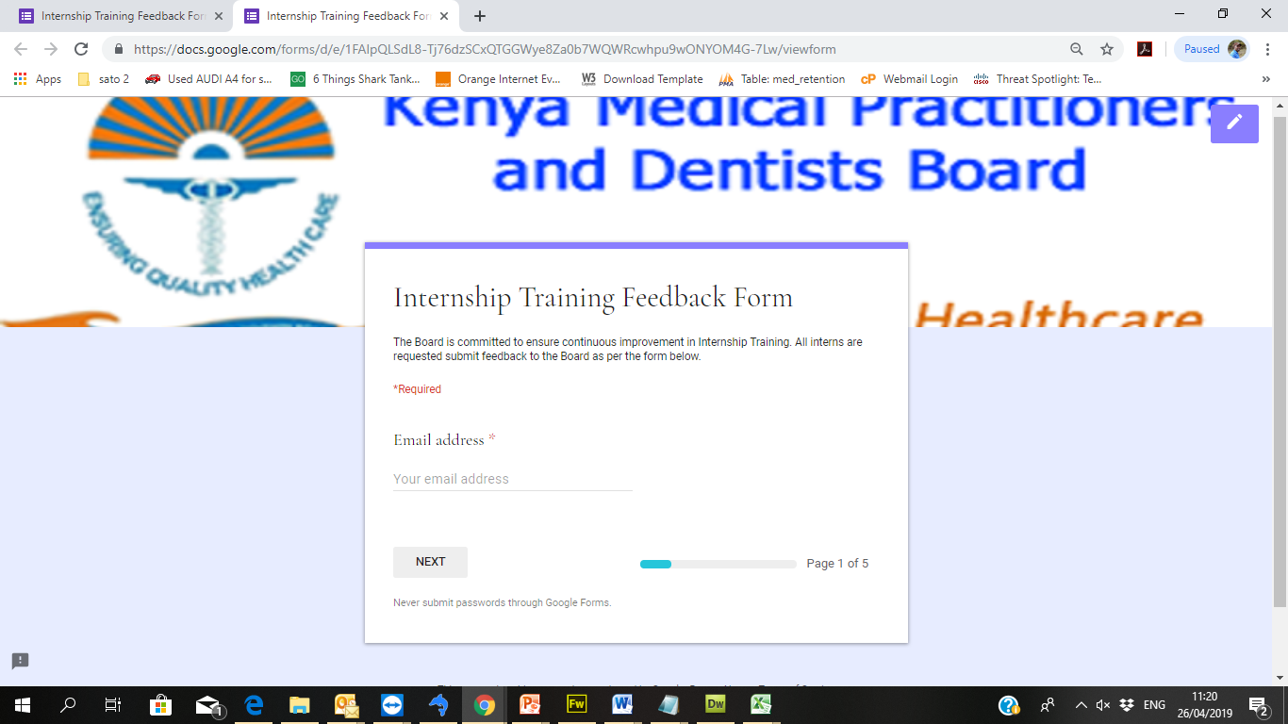
INTERNSHIP FEEDBACK SYSTEM

Slide 21
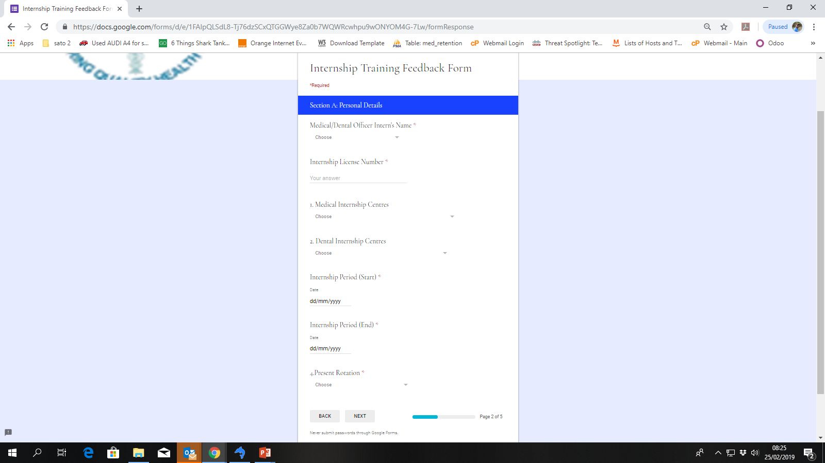
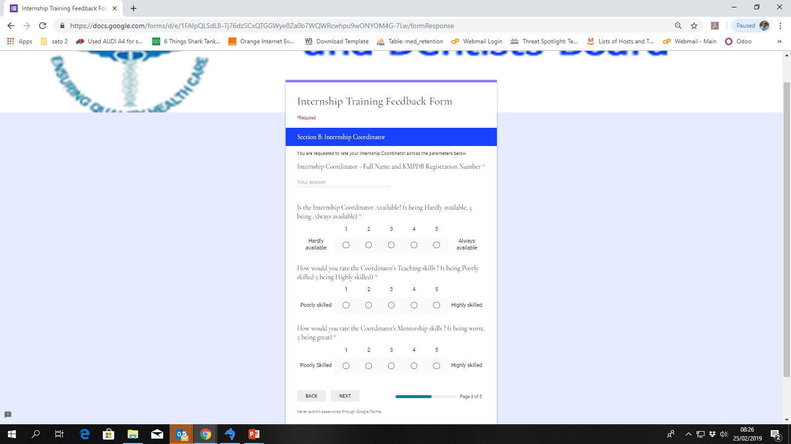
INTERNSHIP FEEDBACK SYSTEM

Slide 22
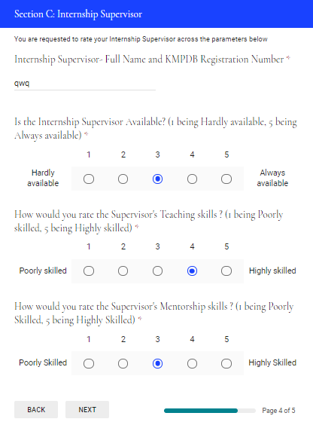
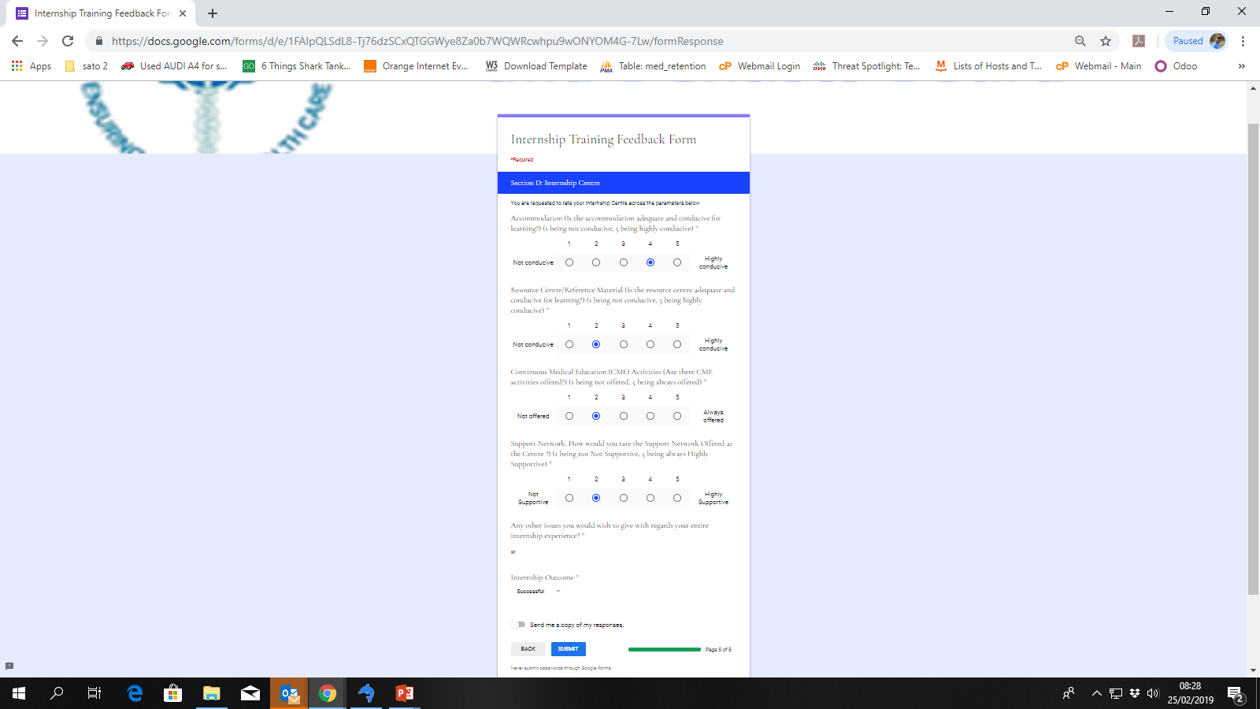
INTERNSHIP FEEDBACK SYSTEM

Slide 23
INTERNSHIP PLACEMENT
COMMITTEE
Inter-Agency committee whose membership comprises of Ministry of Health, the Council and the representatives of Medical and Dental training schools.
Functions
Identifying available slots in approved Internship Centres
Placing interns in respective centres after balloting process
Dealing with matters arising with regards to internship program
Confirming graduands from various training institutions for internship.

Slide 24
CONTACT DETAILS
KMPDC Complex,
P.O Box 44839-00100
Nairobi
Hurlingham
Woodlands Rd, off Lenana Rd
Telephone: 020 2724994, 2728752, 2711478
Mobile: +254 720 771 478, +254 738 504 112
Email: ceo@kmpdc.go.ke
info@kmpdc.go.ke
Website: www.kmpdc.go.ke

Slide 25


